Slide 1
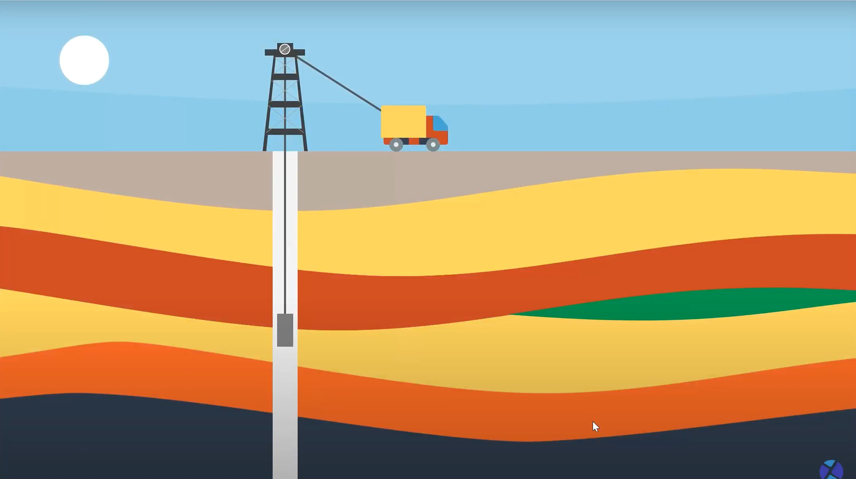
CASE STUDY: FORMATION EVALUATION
INDIAN INSTITUTE OF TECHNOLOGY(INDIAN SCHOOL OF MINES), DHANBAD

Slide 2
AGENDA
Target Region
Well & Stratigraphy
Quality-Control of Wireline-Logs
Optimized Total Porosity calculation (combination of Density and Neutron log) after calibrating with core data
Calculation of Water Saturation with Archie’s and Simandoux’s Method and Generation of Reservoir Flag
Estimation of NTG ratio based on cutoff values
Empirical Porosity-Permeability Relationship Building (Using Core-Data) and Continuous Permeability Profiling

Slide 3
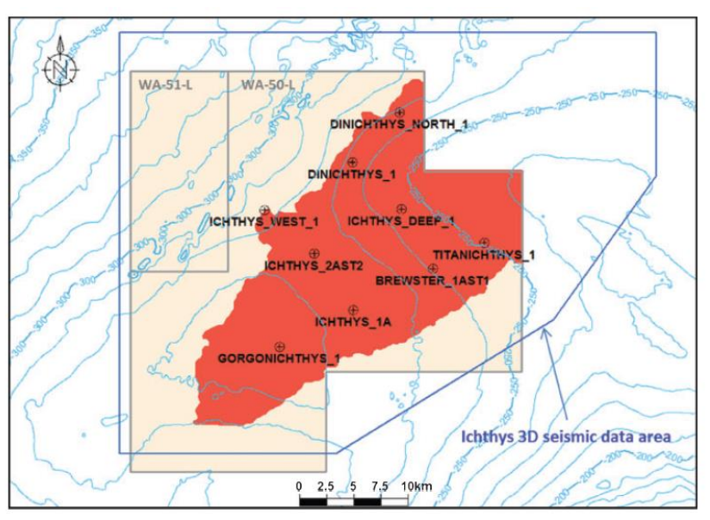
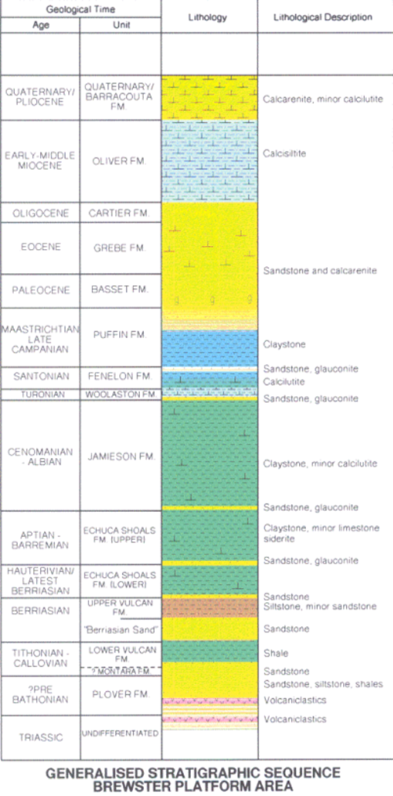
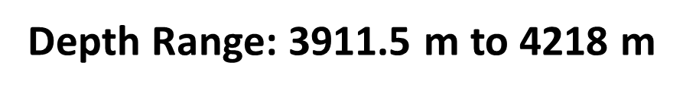
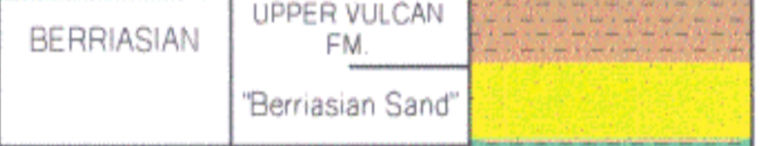
TARGET REGION & STRATIGRAPHY
Target Zone: Brewster Member within Upper Vulcan Formation
Area of Interest: Browse Basin, North-West Shelf, Western Australia

Slide 4
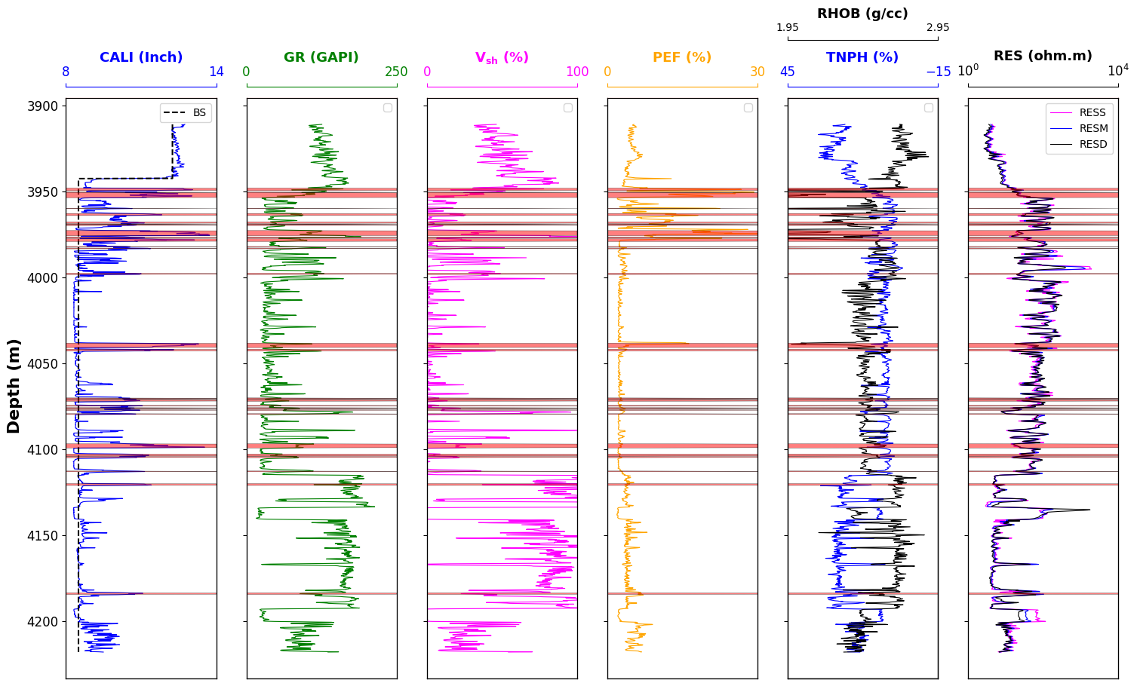
RAW DATA TRACKS

Slide 5
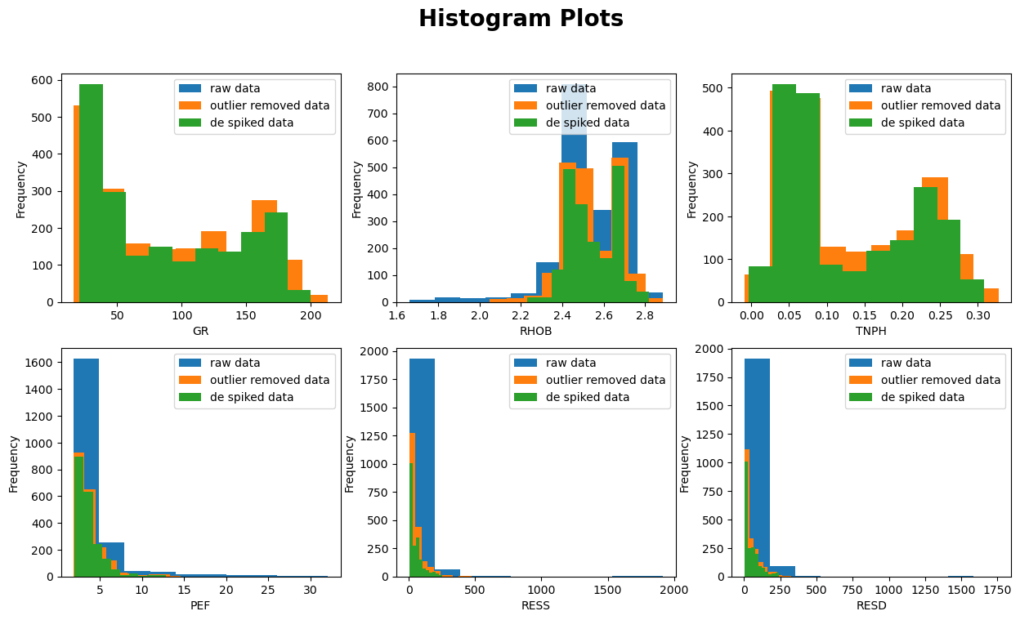
DISTRIBUTION OF RAW & QC DATA

Slide 6
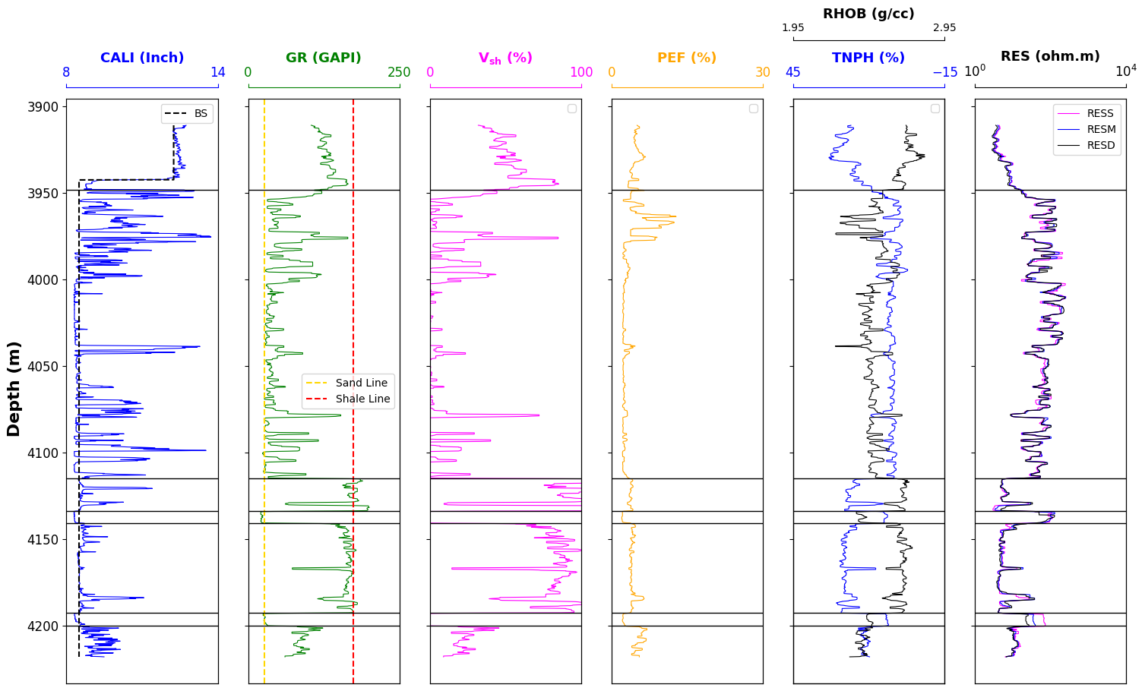
QUALITY CONTROLLED DATA TRACKS

Slide 7
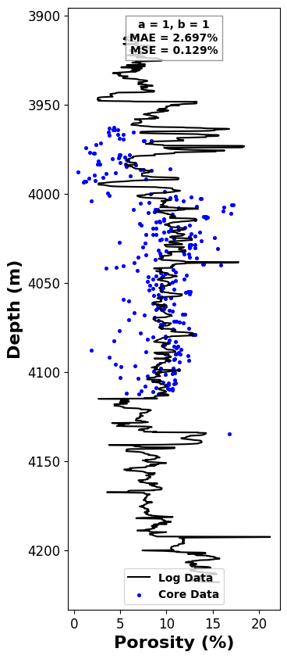
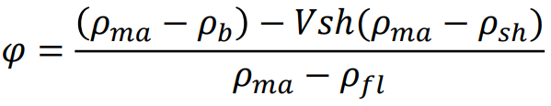
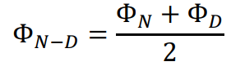
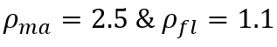
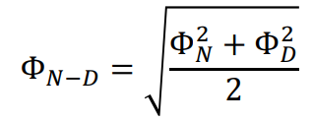
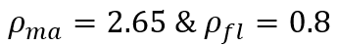
ZONE DIVISION & TOTAL POROSITY
DEPTH RANGE (m) | ROCK TYPE
3911.5 to 3948.5 | SHALE DOMINATED WITH BRINE
3948.5 to 4115 | SANDSTONE DOMINATED WITH GAS
4115 to 4134 | SHALE DOMINATED WITH BRINE
4134 to 4141 | SANDSTONE DOMINATED WITH GAS
4141 to 4192.5 | SHALE DOMINATED WITH BRINE
4192.4 to 4200 | SANDSTONE DOMINATED WITH GAS
4200 to 4218 | SHALE DOMINATED WITH BRINE
Density Porosity Calculation Formula:
For Shale dominated formation with Brine,
For Sandstone dominated formation with Gas,

Slide 8
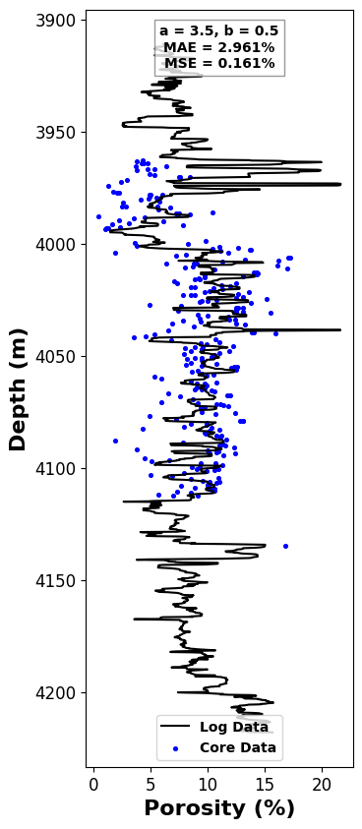

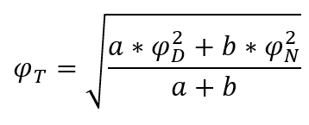
CALIBRATION
We have updated the total porosity formula for Sandstone formation with Gas as follows:
Figure - 1:
a = 3.5; b = 0.5
Mean Absolute Error = 2.961 %
Mean Square Error = 0.161 %
Figure - 2:
a = 1; b = 4
Mean Absolute Error = 2.722 %
Mean Square Error = 0.128 %

Slide 9
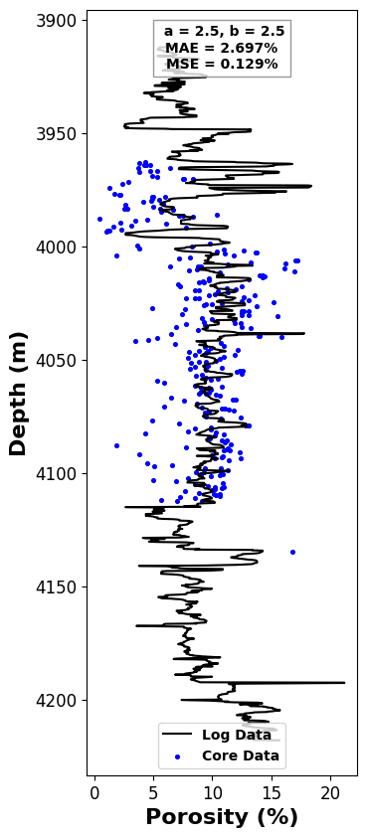

CALIBRATION
Figure - 1:
a = 2.5; b = 2.5
Mean Absolute Error = 2.697 %
Mean Square Error = 0.129 %
Figure - 2:
a = 1.5; b = 1.5
Mean Absolute Error = 2.697 %
Mean Square Error = 0.129 %
After conducting manual tests with various randomly chosen values, it was observed that when a is approximately equal to b, the Mean Absolute Error (MAE) & Mean Squared Error (MSE) do not exhibit significant variation. This observation holds true regardless of whether a and b are small or large. However, challenges arise when the denominator is fixed at 2.

Slide 10
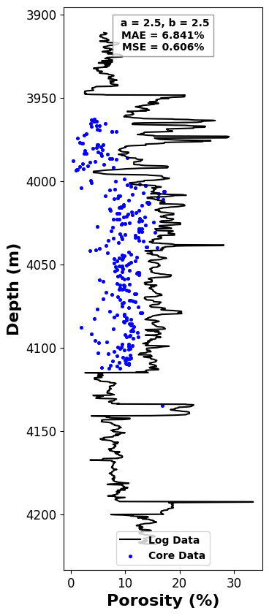
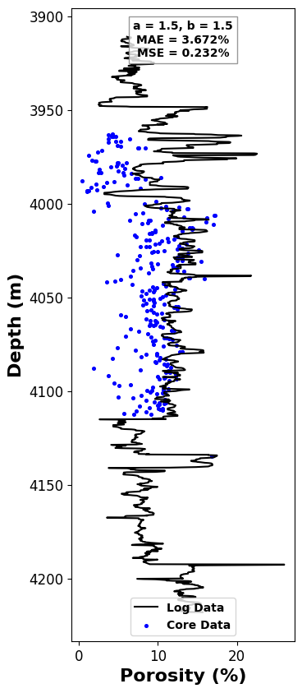
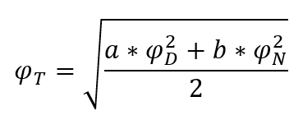
CALIBRATION
We have updated the total porosity formula for Sandstone formation with Gas as follows:
Figure - 1:
a = 2.5; b = 2.5
Mean Absolute Error = 6.841 %
Mean Square Error = 0.606 %
Figure - 2:
a = 1.5; b = 1.5
Mean Absolute Error = 3.672 %
Mean Square Error = 0.232 %
To minimize uncertainty, we employ advanced fitting algorithms, allowing the machine to autonomously execute the complex fitting process and determine the optimal result.

Slide 11
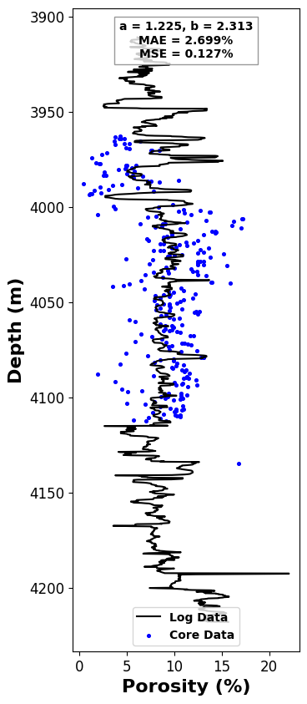

CALIBRATION
We have updated the total porosity formula for Sandstone formation with Gas as follows:
Figure - 1:
a = 1.225; b = 2.313
Mean Absolute Error = 2.699 %
Mean Square Error = 0.127 %
Figure - 2:
a = 0.479; b = 1.082
Mean Absolute Error = 2.637 %
Mean Square Error = 0.113 %

Slide 12

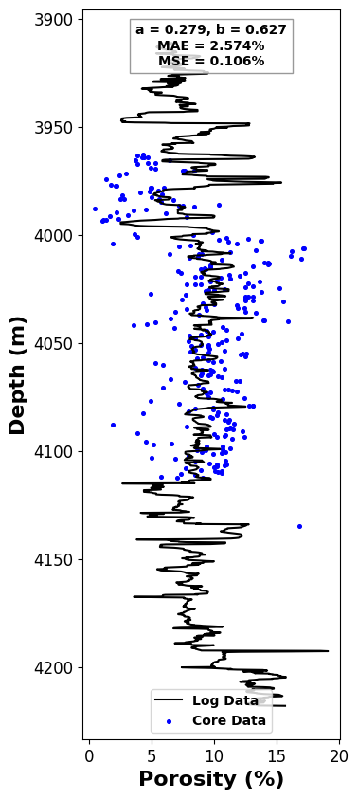
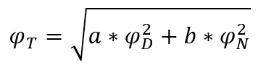
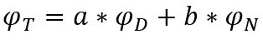
CALIBRATION
We have updated the total porosity formula for Sandstone formation with Gas as follows:
Figure - 1:
a = 0.239; b = 0.541
Mean Absolute Error = 2.637 %
Mean Square Error = 0.113 %
THE MOST INTERESTING RESULT WAS THIS
Figure - 2:
a = 0.279; b = 0.627
Mean Absolute Error = 2.574 %
Mean Square Error = 0.106 %

Slide 13


Calculate water saturation with Archie and Simandoux method
Archie’s method : Sw =${\left(\frac{a}{φ^{m}}\frac{R_{w}}{R_{t}}\right)}^{\left(1/n\right)}$
Simandoux method :
Sw = $\frac{a}{2}⋅\frac{R_{w}}{φ^{m}}\left[\sqrt{{\left(\frac{V_{Sh}}{R_{sh}}\right)}^{2}+\left(\frac{4φ^{m}}{a⋅R_{w}⋅R_{t}}\right)}−\frac{V_{Sh}}{R_{Sh}}\right]$
a=1
m=n=2
R_{w} = 0.12 ohm-m
R_{sh} = 4.68 ohm-m

Slide 14
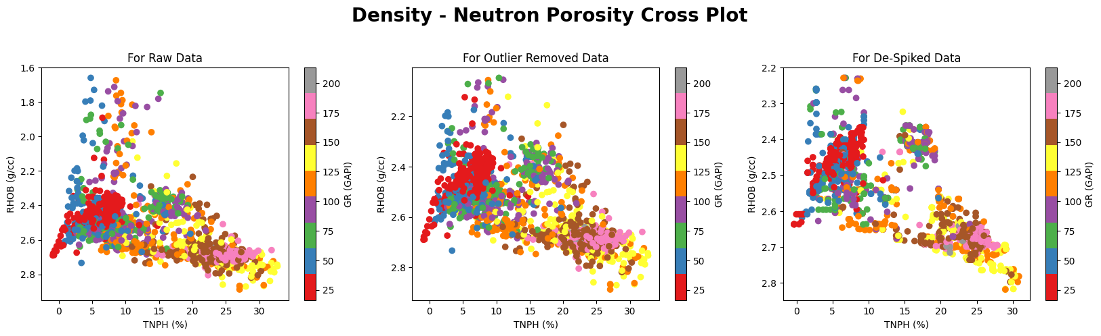
Density - Neutron Porosity Cross Plot

Slide 15
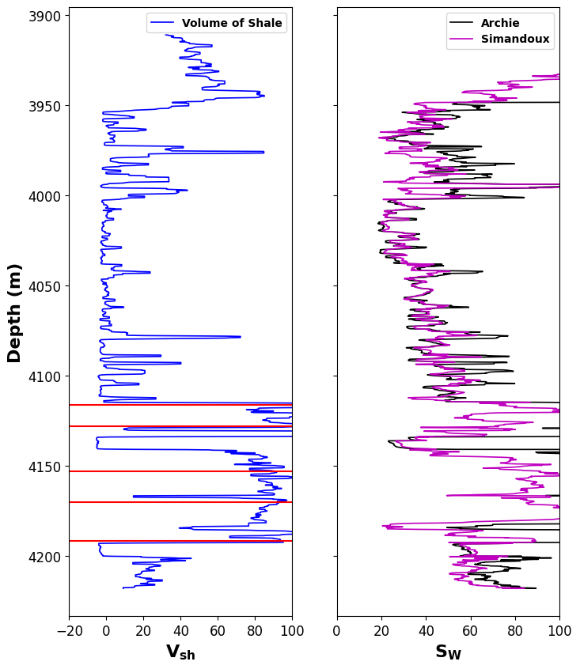
Calculate water saturation with Archie and Simandoux method
Small Deviation
Large Deviation
Pure shale points (V_{sh} > 90%)

Slide 16
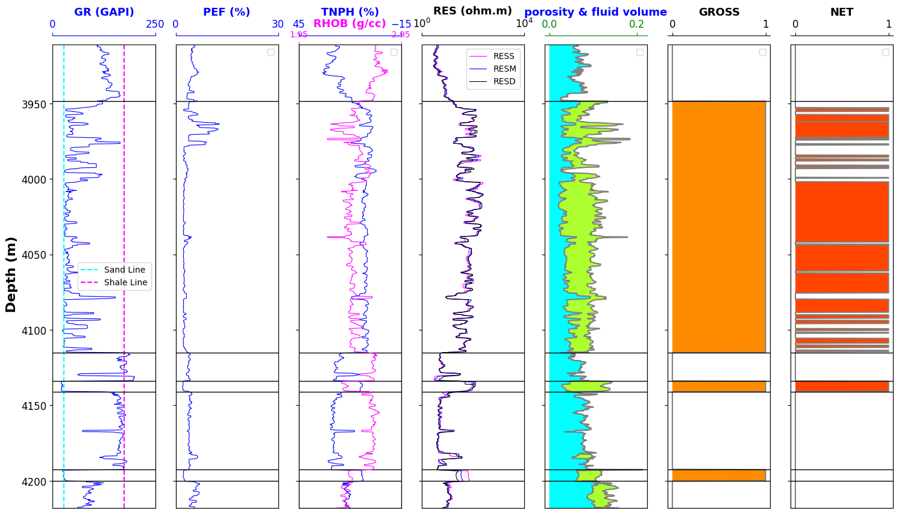
NTG ratio calculation
Cutoffs: Vsh < 50%, φ > 5% and Sw < 50%
Gas
Water

Slide 17
NTG ratio calculation
Gross thickness=depth interval x gross flag
Net thickness = depth interval x net flag
Total thickness
Gross thickness
Net thickness
NTG =
306.93 m.
122.22 m.
Net thickness
181.21 m.
= 0.67
Gross thickness

Slide 18

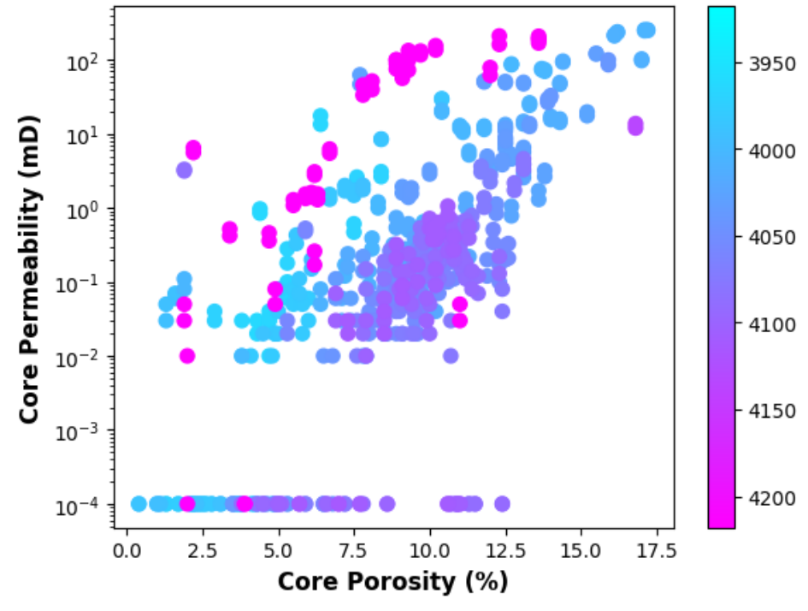
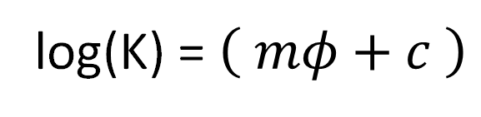
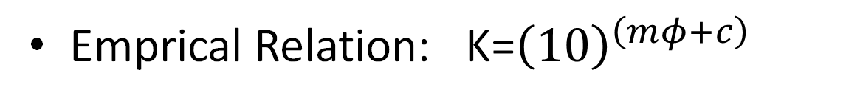
Porosity-Permeability Relation
Emprical Relation: K=${\left(10\right)}^{\left(mφ+c\right)}$
log(K) = $\left( mφ+c \right)$
}
}
Slope
Intercept
Plot: Permeability vs Porosity

Slide 19
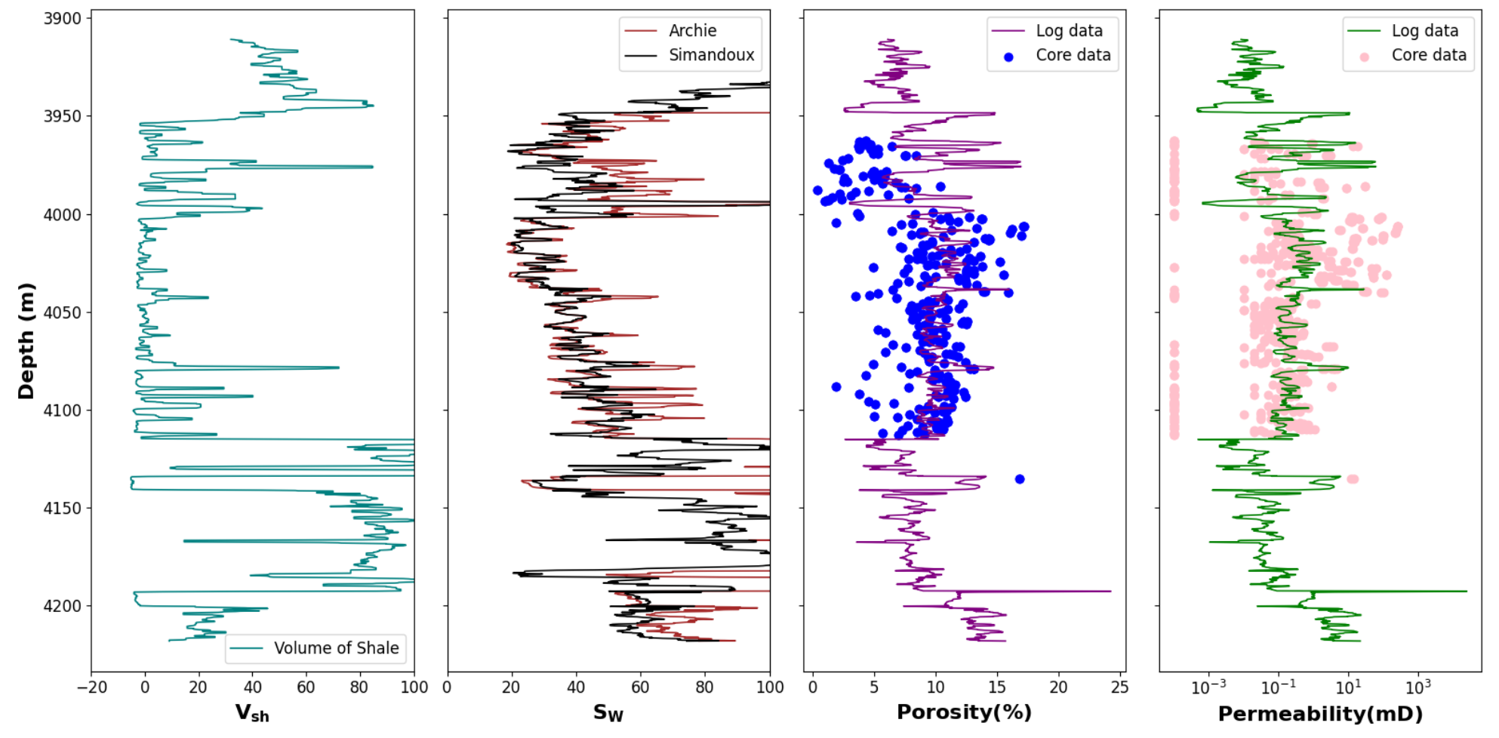
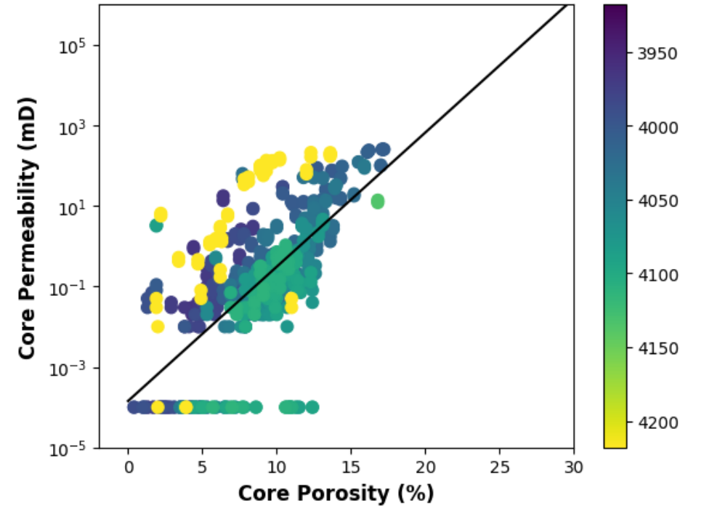
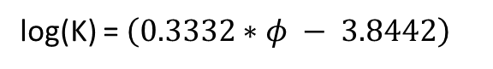
Estimated Continuous Permeability
Core
Data
Porosity
Permeability
Linear
fit
Slope
Intercept
Log
Data
Having Porosity
Estimated Permeability
log(K) = $\left(0.3332∗φ − 3.8442\right)$
Plot: Linear fit of Permeability vs Porosity

Slide 20

Thank You

